Slide 1
QSAIG: Quaker South Asia Interest Group
Presentation to Groups Fair,
Britain Yearly Meeting 2021
Saturday 24th July 2021 2.30 – 4.30pm

Slide 2
Contents
Countries of QSAIG focus
What is QSAIG
QSAIG purposes
What we do
Quakers worldwide
Quakers in South Asia
Quaker meetings in S. Asia
Some groups with whom QSAIG has interacted (see adjacent list)
Forthcoming activities
How you can get involved
Ekta Parishad, India
JaiJagat 2020-2030
Tamwed, Tamil Nadu
Indra Congress
Action for Bhopal
Child Labour-Free Bricks Campaign
Institute of Indian Mother and Child, W. Bengal
Vikramshila Education Resource Centre, Kolkata
Nepal Dialogue Forum for Peace and Human Rights, Germany
Nepal Alternatives to Violence Programme (AVP)
Bangladesh: Gono Unnayan Prochesta (GUP
Myanmar: Scholarships for Street Kids
Asia-Pacific Region: Friends World Committee for Consultation (FWCC)

Slide 3
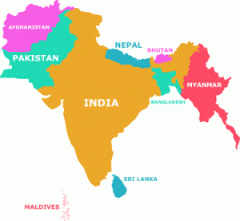
Countries of QSAIG focus

Slide 4
What is QSAIG?
A ‘Quaker-recognised body’ focusing on South Asia (India, Bangladesh, Pakistan, Sri Lanka, Nepal, Afghanistan and neighbouring states)
Started in the 1990’s
100+ members and correspondents
Members have worked in South Asia or are interested in South Asia-related issues

Slide 5
QSAIG Purposes
To assist in the building of a peaceful, just and sustainable world inspired by our Quaker faith and focusing on the South Asia region by:
Connecting people and organisations working/interested in South Asia
Raising awareness about issues in South Asia of interest and concern to Quakers
Providing a source of Quaker support for peace and development initiatives relating to South Asia

Slide 6
What we do
Members and friends take part in various events in the UK on issues and projects relating to South Asia
We connect with friends and partner organisations overseas
We meet annually in London, Leeds or Birmingham
QSAIG website: https://www.qsaig.co.uk/
Produce a newsletter at least once a year

Slide 7
Quakers Worldwide
About 377,000 adult Quakers worldwide
49% in Africa
36% in the Americas
9% in Europe and the Middle East.
The UK (≈ 23,000 adult Quakers) has about three-quarters of the Europe & Middle East total
In Africa and the Americas, a high proportion are Evangelical Friends
Source: Friends World Committee for Consultation (FWCC), 2017:
http://fwccawps.org/wp-content/uploads/2017/10/fwccworldmap2017.pdf

Slide 8
Quakers in South Asia
Historical:
The first Quakers may have visited India around 1657
(Source: Marjorie Sykes, Quakers in India, 1980)
Following the establishment of the Friends Foreign Mission Association in London in 1868, some Quakers travelled to India as missionaries
Local meetings began as part of the welfare work (schools, medical help, etc.)
Mid-India Yearly Meeting formally inaugurated in 1907

Slide 9
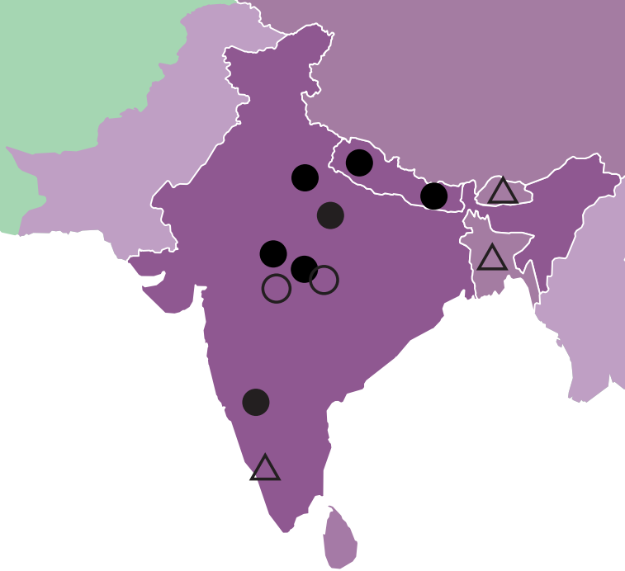
Quaker Meetings in South Asia today
Yearly Meeting
Worship Group
Emerging Meetings
Source: Friends World Committee for Consultation (FWCC)
http://fwccawps.org/wp-content/uploads/2017/10/ fwccworldmap2017.pdf

Slide 10
Quaker Meetings in South Asia
India:
Bhopal YM
Bundelkhand YM
Delhi Quaker Worship Group
General Conference of Friend in India
Mahoba YM, Uttar Pradesh
Mid-India YM, Madhya Pradesh
Nepal:
- Two Evangelical Friends Yearly Meetings
Bangladesh and Bhutan:
- Some Evangelical Friends

Slide 11
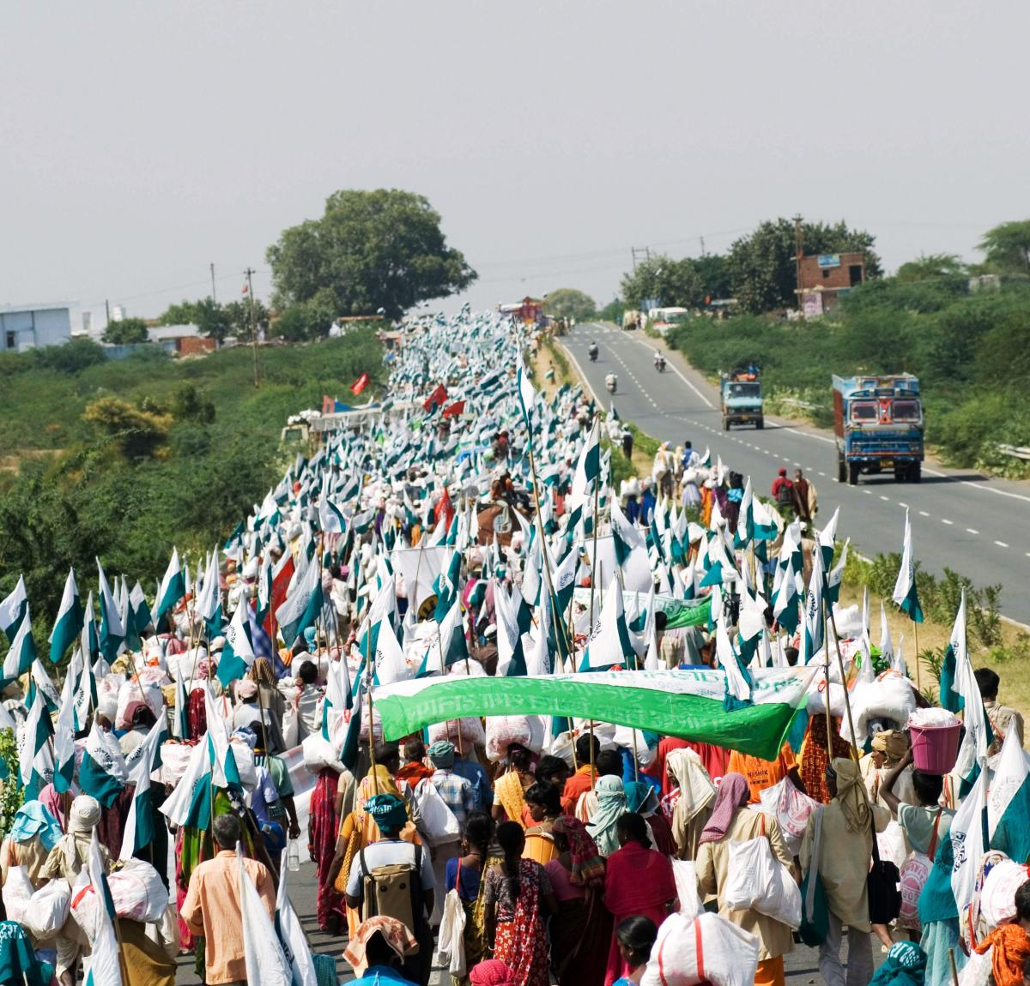
Some Organisations and Individuals with whom QSAIG has interacted in recent years
India: Ekta Parishad
https://www.ektaparishad.in/
A people’s movement dedicated to non-violent action. Aim: to see India’s poorest people gain control over livelihood resources, especially land, water, forest
Activists work towards building community-based governance, local self-reliance, and responsible government
A federation of approximately 11,000 community-based organizations
Currently working in 10 States with India’s most marginalized communities

Slide 12
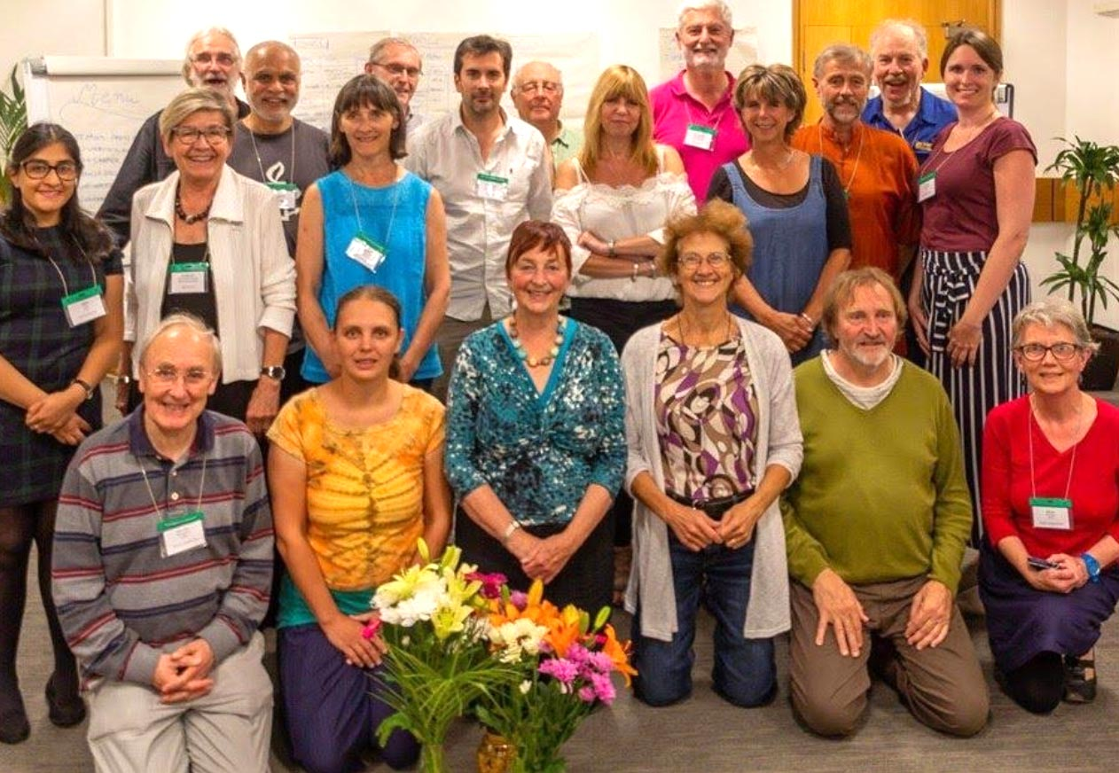
JaiJagat 2020-2030
https://www.jaijagatinternational.org/
JaiJagat 2020 UK
https://jaijagat2020.co.uk/
The Ekta Parishad launched JaiJagat 2020, a new campaign for poor and marginalized people.
It proposes global action, as genuine social change requires collective action across groups & countries
JaiJagat 2020 aims to work with as many organizations as possible at every country and global level
A key component was a Delhi to Geneva march in support of the four pillars of the UN Sustainable Development Goals (SDGs). From Oct. 2019 to March 2020 the marchers covered 2,300 miles but had to halt in Armenia due to the Coronavirus crisis
Now planning its programmes for 2021-2030
Jai Jagat 2020 UK is part of a European network supporting Jai Jagat 2020. It works closely with QSAIG and is recognised as a ‘concern’ by Stourbridge Quaker Meeting

Slide 13
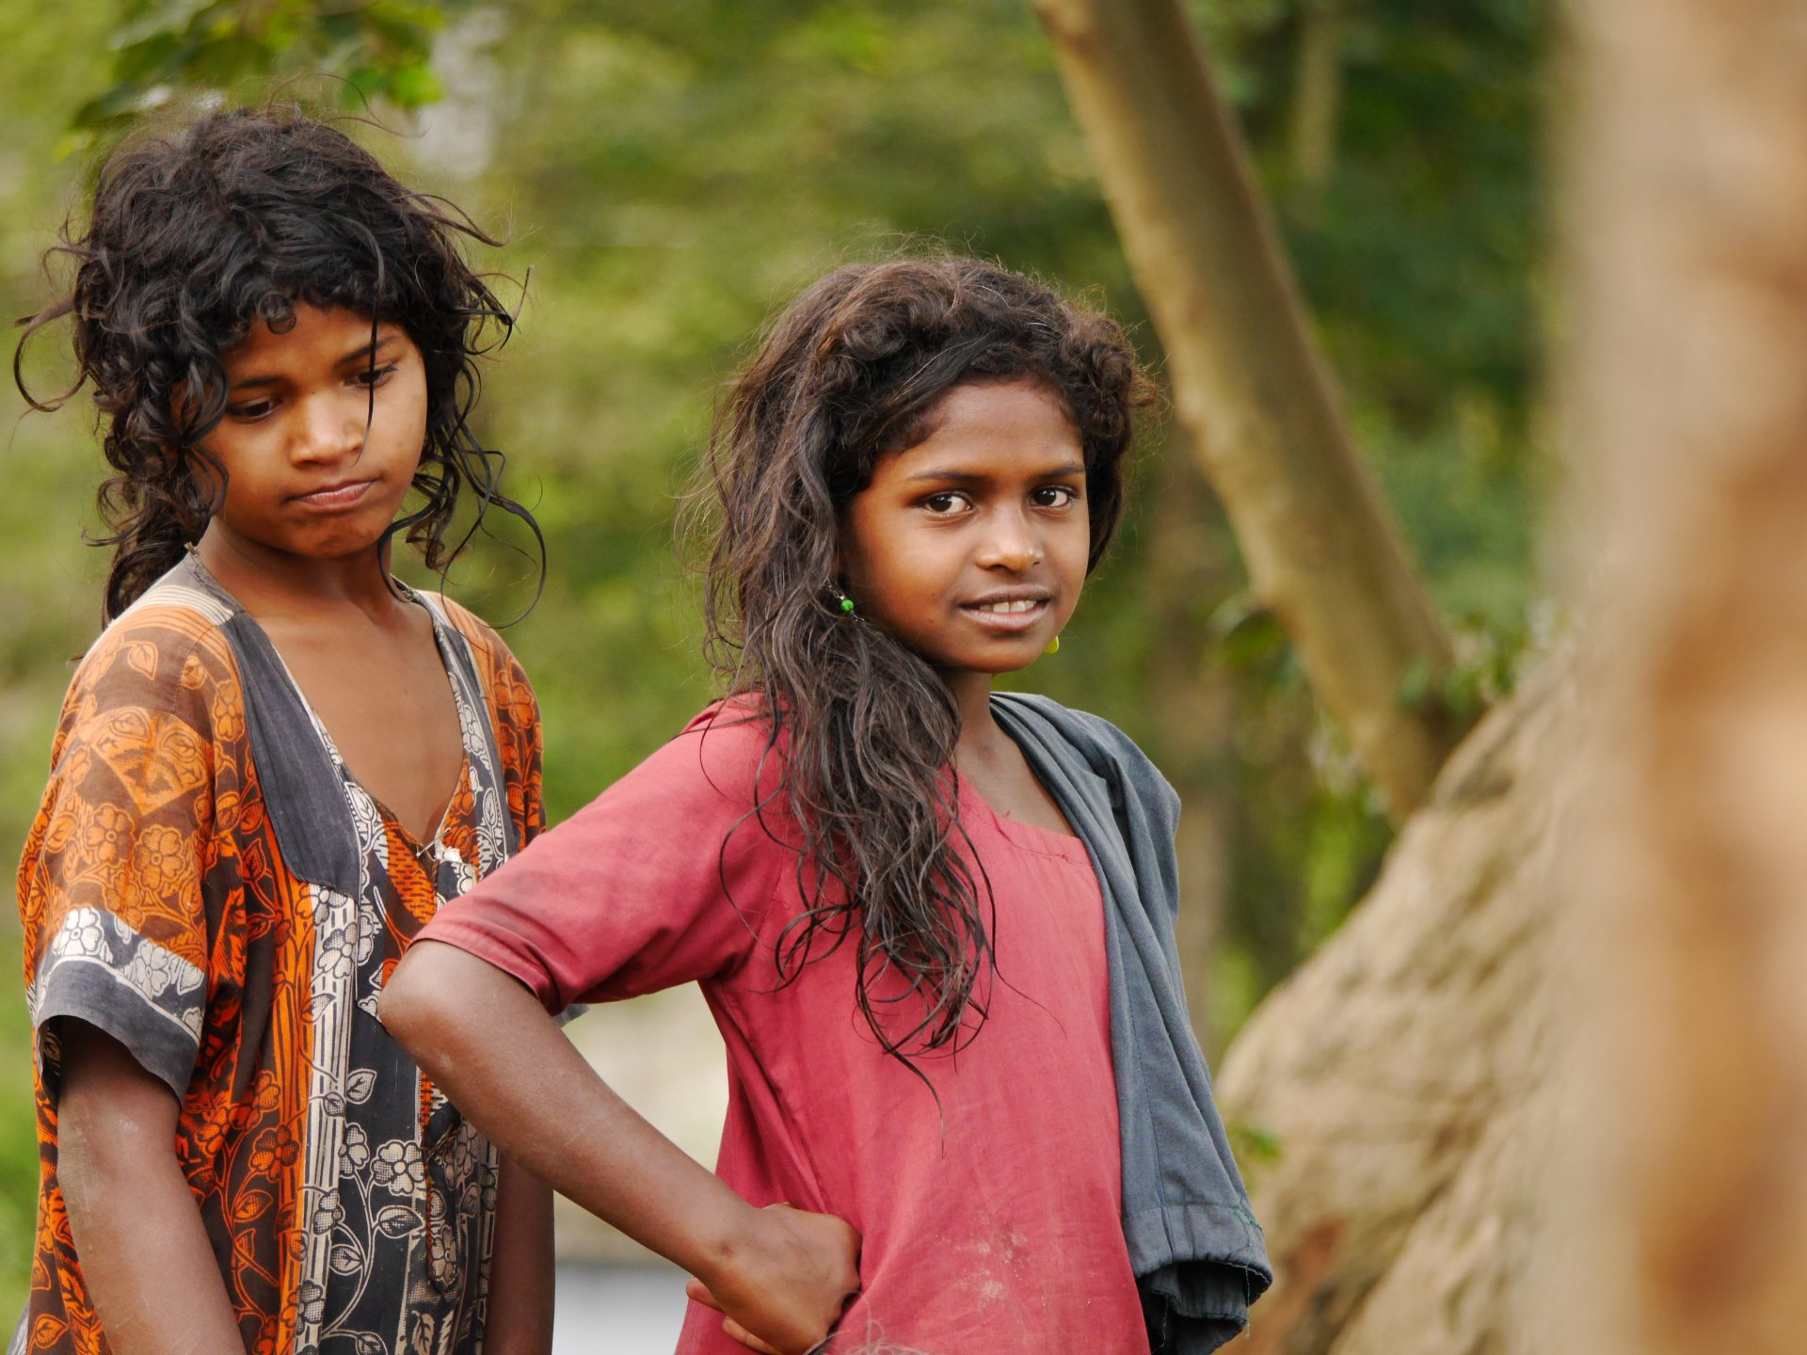
TAMWED associated with the ISLAND Trust, Nilgiri Hills, South India www.tamwed.org
TAMWED (Tamil Nadu, West Devon) is a small charity set up by people in Devon and Cornwall with long-established links to communities in South India. Its current partnership is with the ISLAND Trust (http://islandtrust.org.in/), an NGO that works with tribal people on health, human rights and other issues in the Nilgiri Hills of South India.
Indra Congress and the Study Hall Foundation (SHEF), Lucknow, India www.theindracongress.com http://www.studyhallfoundation.org/index.php
Quakers in Tavistock actively support the Indra Congress (International Development of Reconciliation through the Arts), a global network of young people, artists and educators using the arts for reconciliation and conflict transformation. Indra groups in the UK and worldwide undertake creative projects on issues such as bullying, racism, inter-communal tension or inter-generational misunderstanding. The Indian partner in the Indra Congress is the Study Hall Educational Foundation (SHEF), a formidable contributor to social justice in India. Established in Lucknow in 1994, its objective is imparting quality education to children.

Slide 14
Action for Bhopal
www.actionforbhopal.org
A Quaker-initiated group working for justice and a clean-up in Bhopal
Action for Bhopal is a small but growing group, with members in the UK and Germany. It joins other organizations such as the Bhopal Medical Appeal (UK) – https://www.bhopal.org/ and the International Campaign for Justice in Bhopal (USA) – https://www.bhopal.net/ in working to ensure that pressure is brought to bear on the responsible corporations.
Action for Bhopal aims to keep Bhopal in the public eye, and encourage the company to make a new start by putting right what its predecessor did in the past as well as adopting 21st Century environmental standards for the future.

Slide 15
Child Labour Free Bricks Campaign
Jon Ellis is a retired primary school teacher from Southampton, UK who has worked in child education in W. Bengal for 25 years. He is married to a Bengali and lives almost half of each year in Kolkata
With the help of Sister Cyril at Loreto School Sealdah, Kolkata, Jon initiated the brickfield schools programme of Loreto, which runs 60 open air schools at brick kilns near Kolkata.
Jon helped organize a crowd-fund appeal to support the paid staff of the Child-Labour-Free Bricks campaign
The campaign is hosted for financial purposes by a small local NGO (Howrah Danesh Sheik Lane Navaday Seva Niketan, or NSN for short), secretary Bimal Paul
https://uk.gofundme.com/f/end-child-labour-bricks-in-india

Slide 16
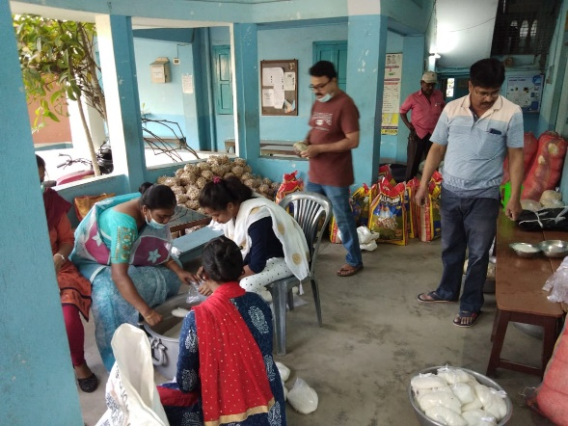
IIMC’s Work in West Bengal – Responding to Coronavirus
IIMC (Institute of Indian Mother and Child) is an NGO providing medical services to poor mothers and children in West Bengal
IIMC works in North and South 24 Parganas, among the most populated and economically backward districts in West Bengal
Dr. Abu B. Siddique, a member of QSAIG, is a Consultant to IIMC and Trustee Member of IIMC-UK (https://www.iimcuk.org.uk/)
Supporting the Educational System in West Bengal:
Vikramshila Education Resource Society is based in Kolkata http://www.vikramshila.org/index.htm and supports education for children from under-resourced and at-risk sections of society
It leads initiatives in pedagogy, curriculum development, teacher development programmes, children supplementary learning centres and child protection
Margaret Waterworth, an education specialist and QSAIG member, has been involved with Vikramshila for over a decade

Slide 17
Nepal Dialogue Forum for Peace and Human Rights
http://nepal-dialogforum.org/
Birgit Felleisen is co-ordinator of the Nepal Dialogue Forum, a network of German NGOs who support projects in Nepal and work for human rights and peace advocacy at the German Parliament and other German institutions, the EU and sometimes at UN level
The Forum’s main topics are social inclusion, transitional justice (including human rights and impunity), and economic, social and cultural rights with an emphasis on the right to food
Birgit is a member of Berlin Meeting and her work email is: koordination@nepal-dialogforum.de
Nepal Alternatives to Violence Programme (AVP)
https://www.facebook.com/Alternatives-to-Violence-Program-AVP-Nepal-548791658521597/
Quakers, through QPSW, have had contacts with AVP Nepal since 2004. It is a voluntary network that runs experiential training workshops where participants can explore alternative ways of dealing with violence/conflict in their personal, family and professional life. The Nepal co-ordinator is Subhash Kattel, hpdnepal@hotmail.com

Slide 18
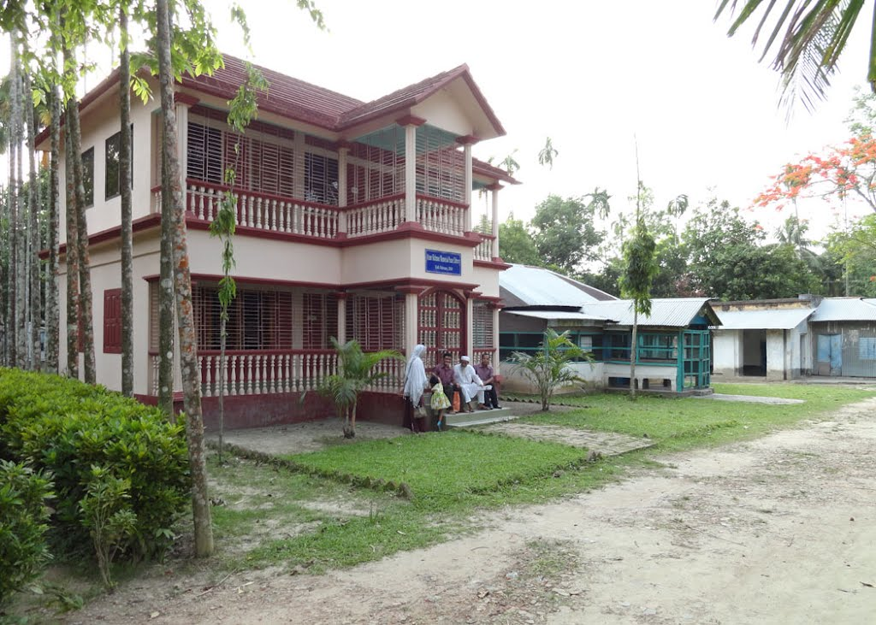
Bangladesh: Gono Unnayan Prochesta (GUP)
https://www.gupbd.org/
Quakers have had links with GUP ( ‘People’s Development Efforts’) since it began in 1973 after the War of Liberation
GUP has expanded over the years and currently works in agricultural extension, credit programmes, handicrafts, training programmes and disaster risk management
In 1982 a Peace Centre was established in Rajoir for training on peace and non-violence and to promote mediation and conflict transformation
In the 2000’s Settle Quaker Meeting helped raise funds to re-build the Peace Centre with donations from over 100 individuals, organisations and trusts, and Quaker Meetings as far afield as Tokyo and Texas.
GUP Peace Centre, Rajoir, Bangladesh

Slide 19
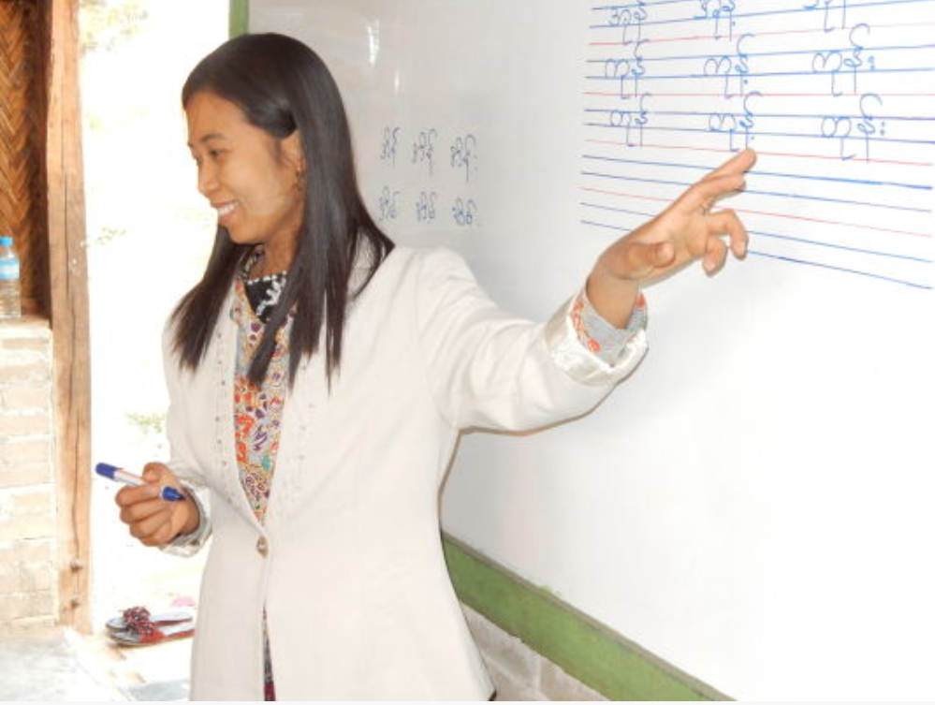
Myanmar: Scholarships for Street Kids https://www.s4sk.org.uk
&
Hope for Shining Stars (Myanmar NGO)
S4SK and H4SS – Background:
In 2007 the first classes for out-of-school children and scholarships provided on the initiative of John McConnell, a British Quaker who was teaching conflict resolution skills in Yangon at the time.
Scholarships for Street Kids (S4SK) established as a UK charity in 2009
By 2013 a strong team of local staff and supporters in Myanmar, and Hope for Shining Stars registered as an NGO in 2016
Most of the children helped are out-of-school and working in full-time jobs from as young as 8 or 9.

Slide 20
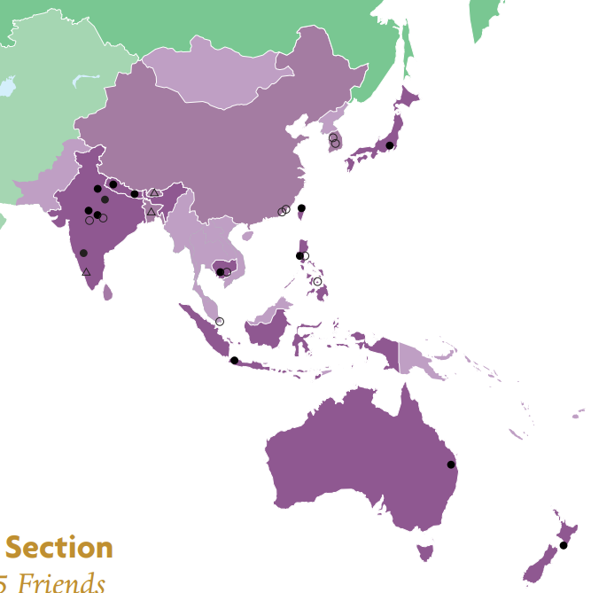
Friends World Committee for Consultation (FWCC) – Asia West Pacific Section
http://fwccawps.org/
FWCC’s purpose is to encourage fellowship among all branches of the Religious Society of Friends
FWCC’s World Office is at Friends House, Euston, London
The Asia West Pacific Section Clerk: Jonathan Fletcher, New Zealand
AWPS Secretary: Ronis Chapman, Canberra Regional Meeting, Australia – contact: ronisc@fwccawps.org

Slide 21
QSAIG Forthcoming Activities
Thursday 5th August 2021 at 12.30pm – QSAIG Special Interest Group meeting (on ZOOM) at Britain Yearly Meeting – OPEN TO ALL, details at QSAIG Website
Saturday 23rd October 2021 at 10.00am – QSAIG AGM in London
Likely to be a ‘blended’ meeting of ZOOM and personal attendance – details on QSAIG website
How you can get involved
Join QSAIG (see website for details)
Send articles for our newsletter
Come to our meetings (on-line or in person)
Pass on info about QSAIG to your local meeting

Slide 22
If you would like to chat with our QSAIG members attending the BYM Group Fair, we would be pleased to meet you and try to answer any questions.
Thank You

